Slide 1

DEPARTMENT OF ARTIFICIAL INTELLIGENCE AND DATA SCIENCE
Artificial Neural Networks and Deep Learning: 21ADG64
LA1 - Seminar
“Empowering LLM applications through LangChain”
Presented By
Yash Trivedi
[1NT21AD062]
Name of the Course Instructor Dr Meenakshi

Slide 2

CONTENTS
Introduction and Motivation
Methodology and Approach
Results and Analysis
Conclusion and Future Recommendations
Demo video of code
Github link of PPT and Code
References

Slide 3
INTRODUCTION
What is LangChain?
LangChain is an open source orchestration framework for the development of applications using large language models (LLMs). Available in both Python- and Javascript-based libraries, LangChain’s tools and APIs simplify the process of building LLM-driven applications like chatbots and virtual agents.
At LangChain’s core is a development environment that streamlines the programming of LLM applications through the use of abstraction: the simplification of code by representing one or more complex processes as a named component that encapsulates all of its constituent steps.

Slide 4
METHODOLOGY AND APPROACH
LangChain's methodology revolves around abstraction and modularity. By abstracting complex processes into named components, developers can build applications using a modular approach, chaining together these components to create sophisticated workflows.
The approach involves integrating various LLMs seamlessly into the development environment, allowing for dynamic comparison of different prompts and models with minimal code rewriting.
Additionally, LangChain provides tools for prompt engineering, memory management, agent-based reasoning, and integration with external data sources, enabling developers to tackle diverse use cases efficiently.

Slide 5
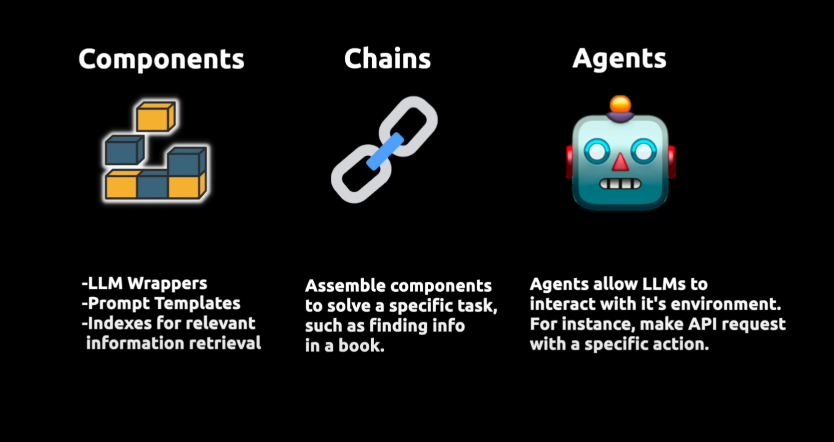

Slide 6
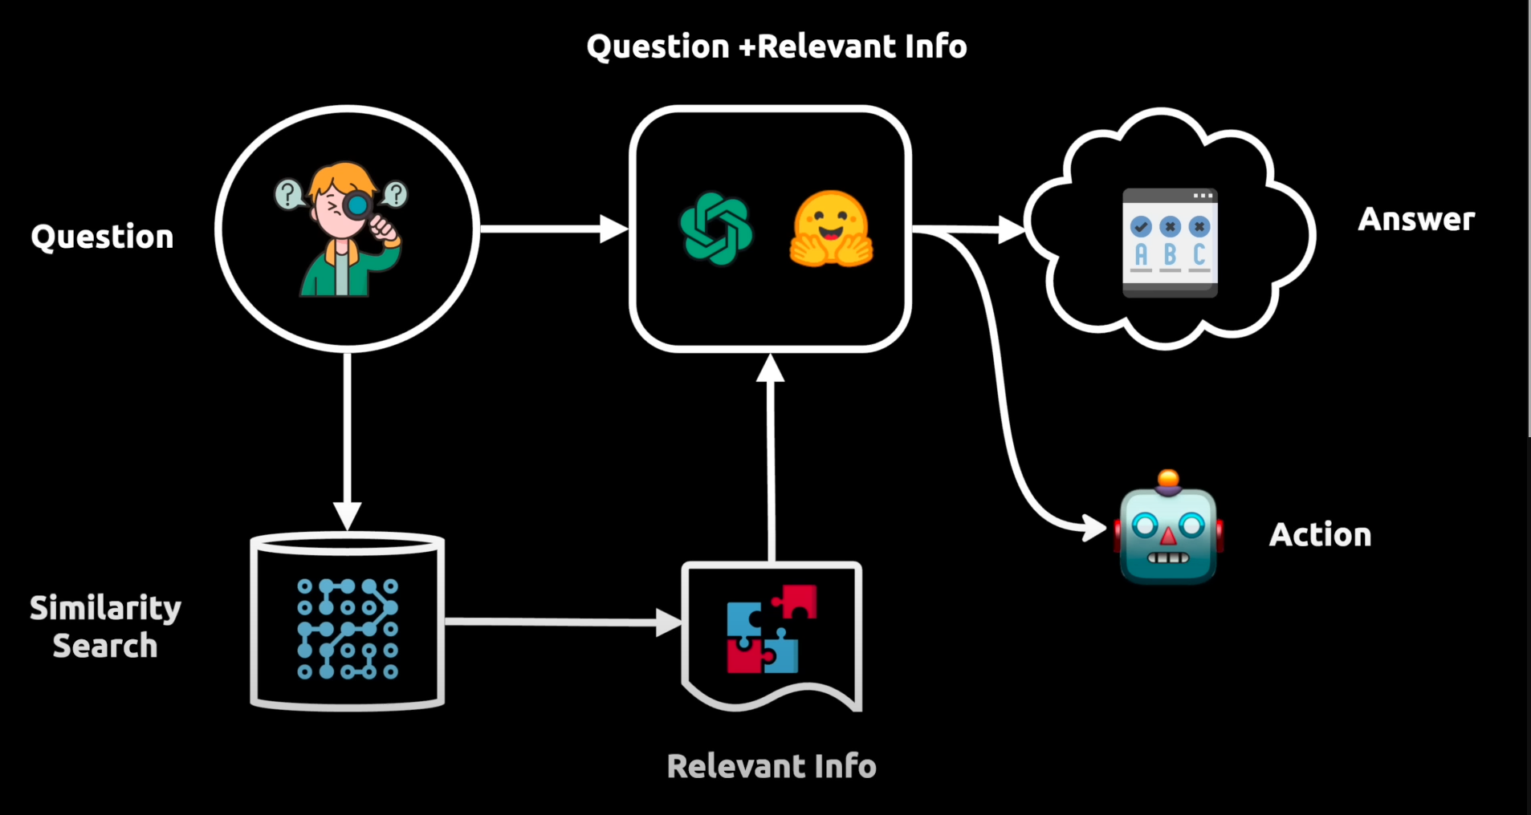

Slide 7
RESULT AND ANALYSIS
The adoption of LangChain has led to significant advancements in the development of LLM-driven applications. Developers using LangChain have reported improved productivity, reduced development time, and enhanced flexibility in experimenting with different LLMs and application architectures.
The framework's modular nature and centralized development environment have contributed to more robust and scalable applications. Furthermore, LangChain's integration with external data sources and software workflows has expanded the capabilities of LLM applications, enabling tasks such as intelligent search, summarization, and virtual agent automation.

Slide 8
CONCLUSION AND FUTURE RECOMMENDATION
In conclusion, LangChain represents a pivotal advancement in the development of LLM-driven applications, offering a comprehensive framework for building, deploying, and optimizing NLP solutions.
As the field of natural language processing continues to evolve, LangChain is poised to play a critical role in accelerating innovation and democratizing access to advanced language technologies.
Moving forward, future recommendations for LangChain development may include enhancing documentation, expanding integrations with additional LLMs and external services, and fostering a vibrant community of contributors and users.

Slide 9
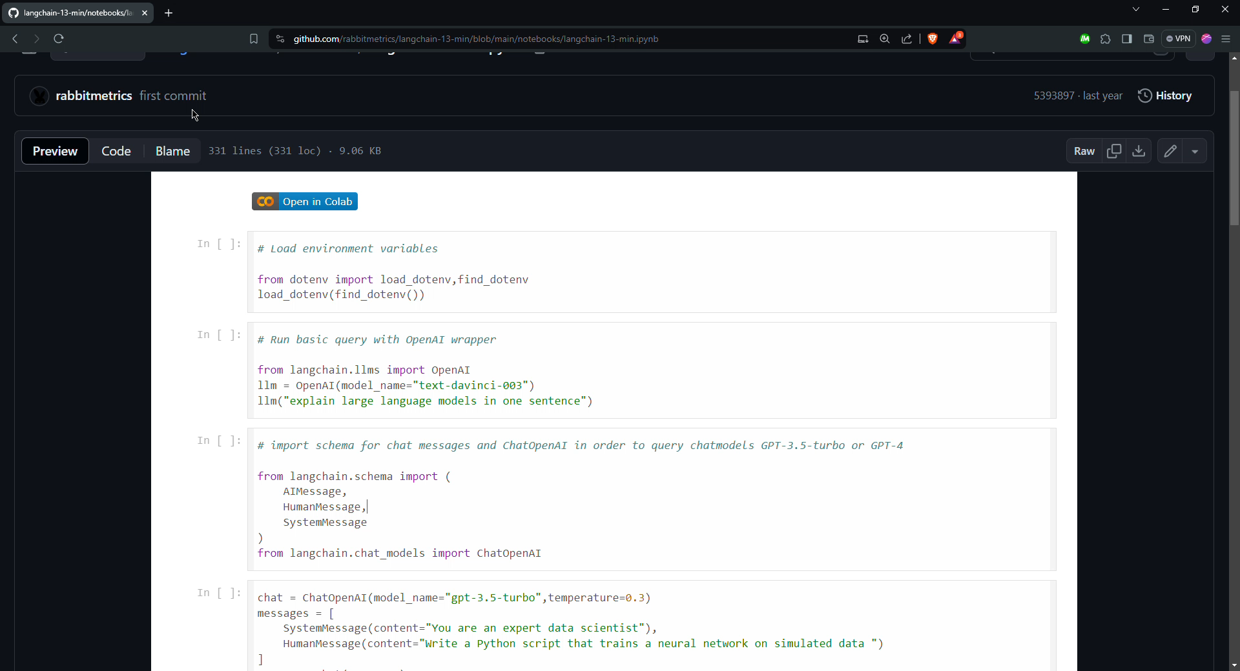
DEMO VIDEO

Slide 10
Github Links
Github Repo

Slide 11
REFERENCES:
LangChain web
IBM LangChain Resource
Documentation
YT Reference

